Slide 1
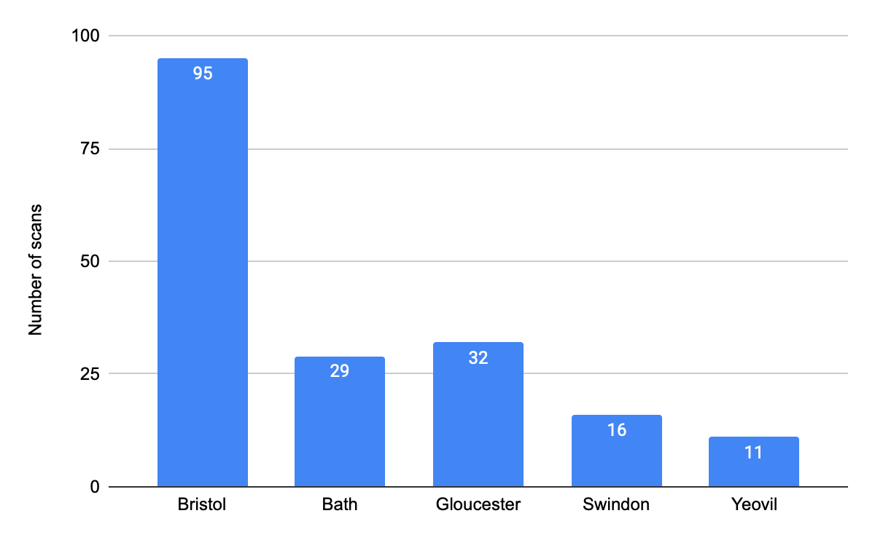
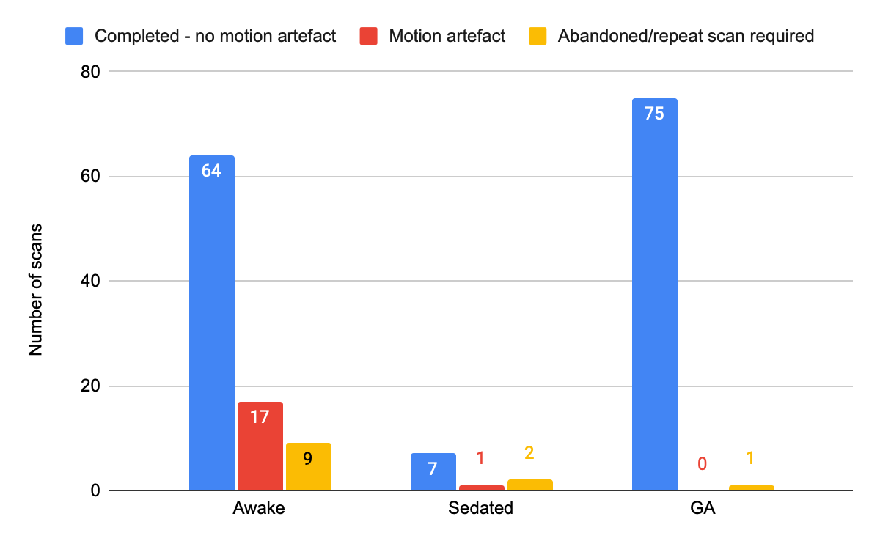
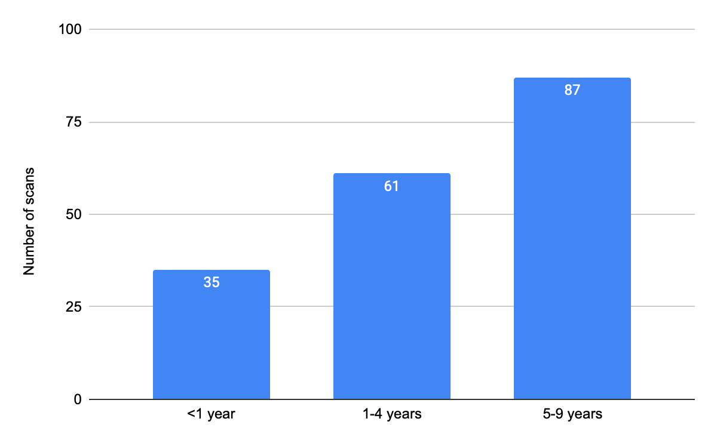
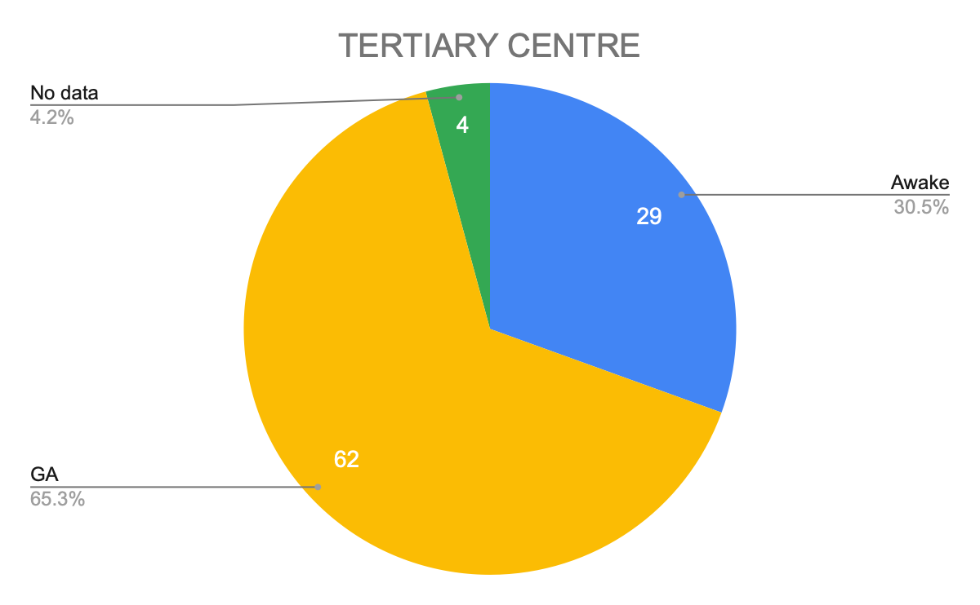
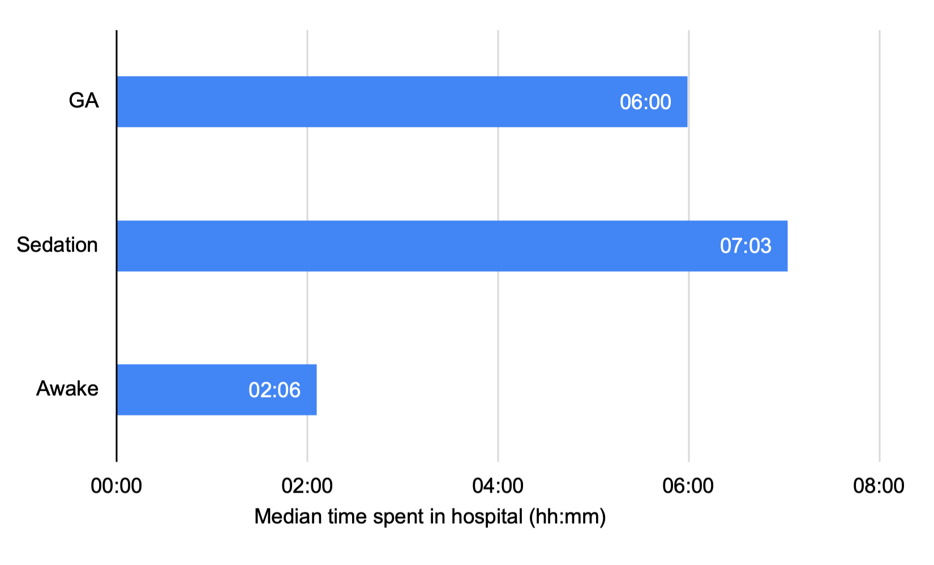
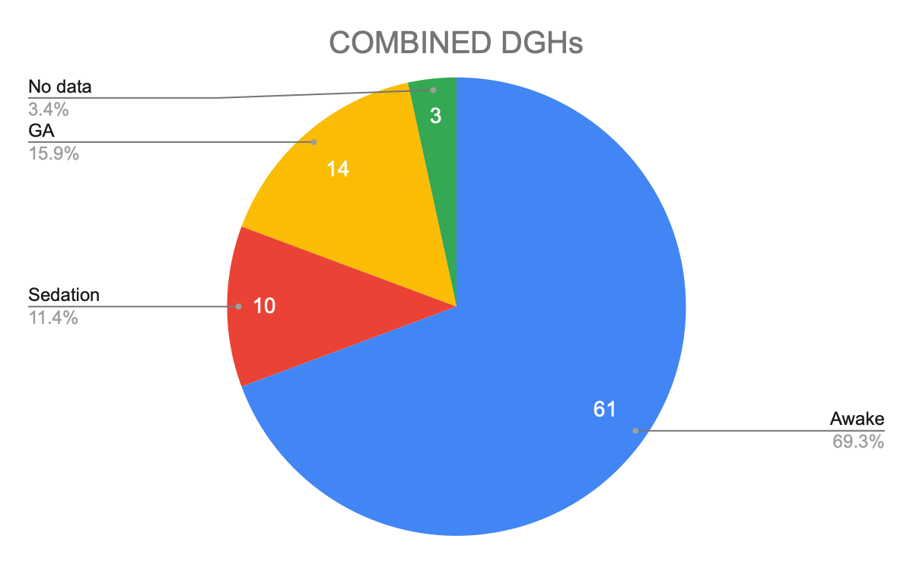
Paediatric MRI Scans: A Regional Service Evaluation
R Powell¹, S Nava², N Wood³, I Ogbu⁴, S Maxwell⁵, J Barnes¹, R Hardy²
1. University Hospitals Bristol & Weston NHSFT, 2. Royal United Hospitals Bath NHSFT, 3. Gloucestershire Royal Hospitals NHSFT, 4. Yeovil District Hospital NHSFT, 5. Great Western Hospitals NHSFT
INTRODUCTION
Magnetic resonance imaging (MRI) is increasingly used in the UK and waiting lists continue to grow¹.
In paediatric patients general anaesthesia (GA) is often required to obtain complete scans without motion artefact, which has associated risks and costs^{2,3}.
Supported by the Severn Trainee Anaesthetic Research Network (STAR), we performed a retrospective review of paediatric MRI scans, with the aim of establishing current practices and protocols and developing best practice guidance.
METHODS
We analysed notes of all patients aged 0-9 years undergoing MRI scans during March 2022 in five hospitals across our region:
Bristol Royal Hospital for Children
Royal United Hospital Bath
Gloucester Royal Hospital
Great Western Hospital Swindon
Yeovil District Hospital
Table 1: Inclusion and exclusion criteria
We reviewed notes, scan reports and online systems to identify; anaesthetic practice, including consent, pre-operative assessment and conduct of scan; reported motion artefact or need to abandon scan; adverse events; and duration of Hospital stay.
RESULTS
183 scans performed across the five hospitals.
Figure 1. Breakdown of scans performed by hospital and age
Figure 2. Comparison of the proportion of scans performed awake, sedated or under GA at tertiary centre and DGHs
RESULTS
No scans under sedation involved an anaesthetist.
28% of awake scans and 30% of scans under sedation had motion artefact reported, with 10% and 20% respectively abandoned or with significant artefact that impaired diagnostic ability.
One GA scan was limited by patient instability.
Figure 3. Comparison of motion artefact
Of the 68 outpatient (OP) scans performed awake, only 5 required ward admission.
Sedation and GA required on average a 4 hour longer ward admission than awake scans.
Figure 4. Median duration of hospital stay
No serious adverse events were reported and there were no unplanned overnight admissions.
Documentation of play therapist input and adjuncts used to aid success of awake scans was limited in all hospitals.
CONCLUSIONS
Reducing number of scans performed under GA has potential benefits for patient safety, list efficiency, bed occupancy and cost-saving.
There is need for careful patient selection and preparation to ensure this does not affect diagnostic yield.
In collaboration with the cross-regional Optimising MRI Pathways for Children Working Group, future plans include:
Creating an online platform to share successful practices within the region (accessed via adjacent QR code).
Developing regional best practice guidelines for paediatric MRI
Supporting business proposals for radiology-based play specialists
Undertaking ongoing audit
ACKNOWLEDGEMENTS
With thanks to STAR for their support in carrying out this project and to Catherine Carpenter-Clawson from the SW Children in Surgery Operational Delivery Network for her encouragement and ongoing work.
REFERENCES
Diagnostic Imaging Dataset Annual Statistical Releases
Healthcare Safety Investigation Branch. Undiagnosed Cardiomyopathy in a Young Person with Autism 2020 (bit.ly/3x7ODdg)
Van der Griend BG et al. Postoperative mortality in children after 101,885 anesthetics at a tertiary pediatric hospital. Anaesth Analg 2011; 112: 1440-7
INCLUSION CRITERIA | EXCLUSION CRITERIA
Age 0-9 years undergoing MRI scan | Sedated and intubated on PICU
Elective and emergency | Intraoperative MRI
Inpatient and outpatient | Postoperative MRI still under GA

